Slide 1
Machine Learning Tools applied to Low-Resource and Under-Researched Languages
Guillem Gili i Bueno
Notes:
Comments during presentation 13.05.2026: ‘... intensive’ instead of ‘consonant incentive’, ‘written’ about the vowels (they are not written); dipthongs for dz … they are called ‘affricates’ -> CORRECTED
Suggestion: Have a few words in a slide before this one stating what the aim of the project is and its significance. Short & punctual. -> ADDED RESEARCH MOTIVATIONS
Suggestion: Add a slide with prior work/work on the same topic that precedes this project (and if none exists, state that or make parallel to other works on the same topic but in other lang families)
Citation should only be Dell & Elm… 2002, along with a p. X if this comes from some specific page; and then a separate section at end of slides with your list of References

Slide 2
Montreal Forced Alignment applied to Tachelhit and Amazigh languages
Guillem Gili i Bueno
Notes:
Comments during presentation 13.05.2026: ‘... intensive’ instead of ‘consonant incentive’, ‘written’ about the vowels (they are not written); dipthongs for dz … they are called ‘affricates’ -> CORRECTED
Suggestion: Have a few words in a slide before this one stating what the aim of the project is and its significance. Short & punctual. -> ADDED RESEARCH MOTIVATIONS
Suggestion: Add a slide with prior work/work on the same topic that precedes this project (and if none exists, state that or make parallel to other works on the same topic but in other lang families)
Citation should only be Dell & Elm… 2002, along with a p. X if this comes from some specific page; and then a separate section at end of slides with your list of References

Slide 3
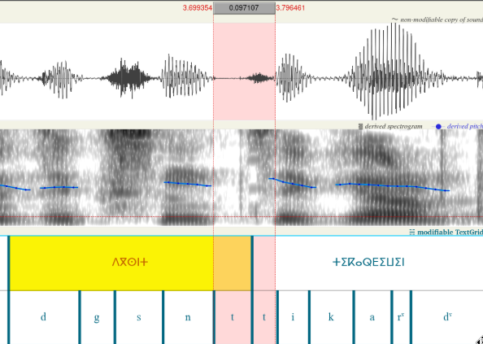
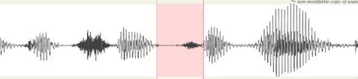

Forced Alignment
Notes:
1.5 min

Slide 4
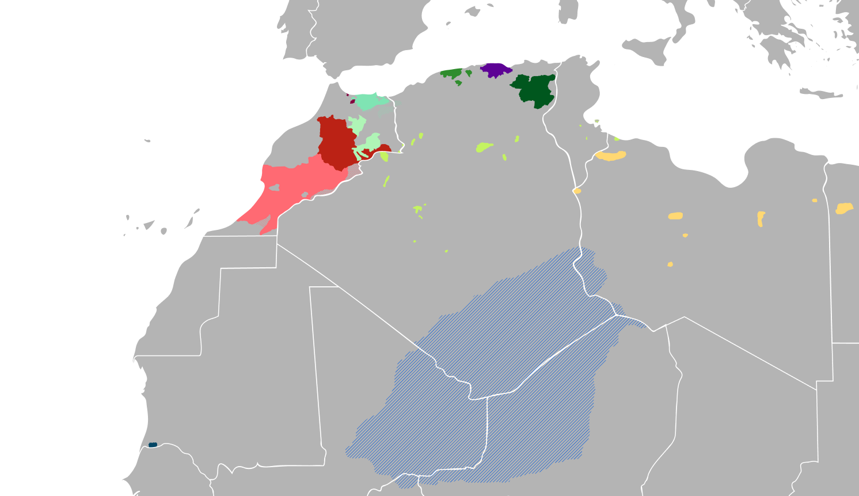
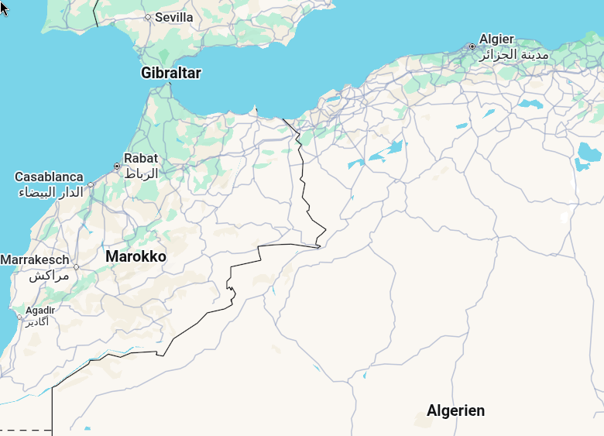
Tachelhit(shi) Forced Alignment
rif
kab
tzm
shi
Map SRC: https://en.wikipedia.org/wiki/Berber_languages and maps.google.com
Notes:
1.5 min

Slide 5
Ontology Berber
ber (ISO)
atla1275 (Glottolog)
kab (ISO)
shi (ISO)
tzm (ISO)
rif (ISO)
zgh (ISO)

Slide 6
Ontology Berber
ber (ISO)
atla1275 (Glottolog)
kab (ISO)
shi (ISO)
tzm (ISO)
rif (ISO)
Adjusting
32.7 min(mostly shi)
zgh (ISO)
Training
24.45 hrs
https://huggingface.co/datasets/fsicoli/common_voice_22_0
Notes:
3.5

Slide 7



Writing systems
kab(Taqbaylit, Kabyle)
zgh (Standard Moroccan Amazigh)
<-Dataset train
<-Dataset adjust
<- limited real usage
shi (Tachelhit, Tachlhit, Shilha)
tzm (Tamazight, Atlasic, Central atlas Tamazight)
<-Dataset adjust
<-Dataset adjust
Tamazight/Amazigh/Berber tend to also be used as an umbrella term to reference all Berber languages.
Notes:
4.5

Slide 8





Research motivations
Good benchmark for Forced Alignment
  Consonant-intensive language
  Fully-unvoiced sentences
  Epenthetic, non-contrastive (e or sometimes non-written) vowels are common
  Many realisations for the explicitly written vowels (a,i,u)
Low resource language
  Big amount of theoretical research
  Contradicting statements in research
  Bypass lack of corpus
    Family language corpus
+ REPRODUCEABILITY
"Syllables in tashlhiyt berber and in moroccan arabic"
F Dell, M Elmedlaoui - 2002
Notes:
6.5

Slide 9
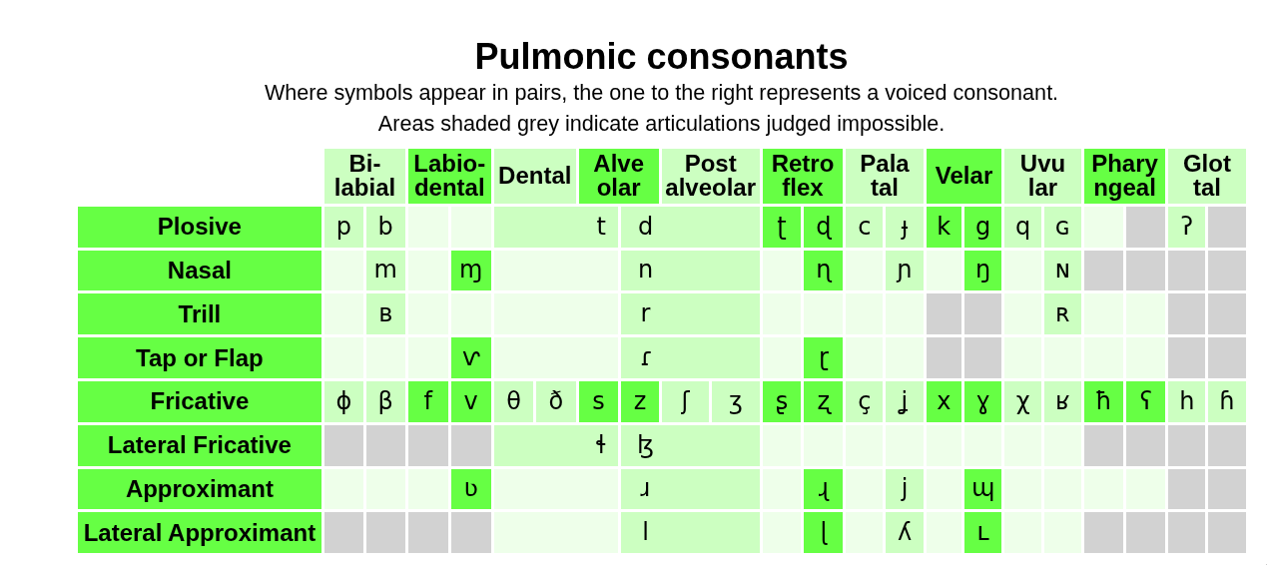

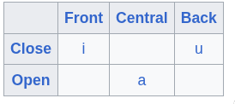


Phonological space: zgh-only
[w]
[ˤ]
[ˤ]
[w]
[w]
[w]
[w]
[ˤ]
[ˤ]
[ˤ]
[ˤ]
[w]
[w]
*
*
e
geminates (long)
xʷ theoretically exists in kab, but no examples in 25h corpus
* pharyngeals are epiglottal in shi
https://en.wikipedia.org/wiki/Shilha_language#Phonology
https://en.wikipedia.org/wiki/Central_Atlas_Tamazight

Slide 10
Phonological space: intersection kab and zgh
[w]
[ˤ]
[ˤ]
[w]
[w]
[w]
[w]
[ˤ]
[ˤ]
[ˤ]
[ˤ]
e
geminates (long)
Table from https://www.ipachart.com/
Notes:
AFRICATES = /ts/dz/

Slide 11
Phonological space: kab-only
[w]
[ˤ]
[ˤ]
[w]
[w]
[w]
[w]
[ˤ]
[ˤ]
[ˤ]
[ˤ]
e
geminates (long)
https://en.wikipedia.org/wiki/Kabyle_language
Notes:
9.5

Slide 12
Shared orthography: kab+zgh (excluding tifinagh)
PHARYNGEALIZATION
ṣ -> /sˤ/
ẓ …
ṭ …
ḍ …
ṛ -> /rˤ/
ḥ -> /ħ/
“e” -> /ə/
“e” -> //
“e” -> /e/
“e” -> /i/
“e” -> …
“x” -> /χ/
“ɣ” -> /ʁ/
“y” -> /j/
GEMINATES
“gg” -> /g:/
“bb” -> /b:/
…

Slide 13
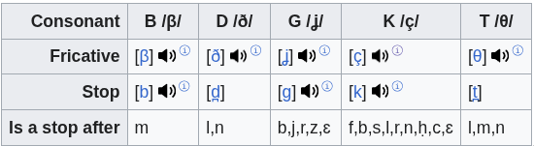
Realizations: affricates vs stops
kab
zgh
/β/
/b/
“b”
“b” -> /b/
“t” -> /t/
“d” -> /d/
“g” -> /g/
“k” -> /k/
/θ/
/t/
“t”
“d”
/ð/
/d/
“g”
/ʝ/
/g/
/ç/
/k/
*β,θ and other first-liners are the default pronunciation, their alternative only being used after specific consonants (or geminating)
“k”
https://en.wikipedia.org/wiki/Kabyle_language

Slide 14
Orthography ambiguity:
kab
zgh
/mʷ/
/m:w/
Unambiguous writing of labial., pharyng. in Tifinagh
“ⵎⵯ”-> /mʷ/
“ⵙ” -> /s/
“ⵚ” -> /sˤ/
Symbols for spirant. exist but not commonly used:
“ⴸ” -> /ð/ (rarely used)
“ⴷ” -> /d/
“mmw”
/gʷ/
/g:w/
“ggw”
/kʷ/
/k:w/
“kkw”
“xxw”
/χʷ/
/ʁʷ/
Not found in kab corpus
“ɣɣw”
/qʷ/
/q:w/
“qqw”

Slide 15
Pronunciation particularities zgh
Contrastive gemination
tett != ttet
Assimilation (and gemination) forward
at dna -> /ad:na/ (/addna/)
Ambiguous pron. in 3-gemination:
Att ta -> /attta/ or /att.ta/
"Syllables in tashlhiyt berber and in moroccan arabic"
F Dell, M Elmedlaoui - 2002

Slide 16
Irregularities in orthography:
kab
zgh
/nw/
/nbw/
/npw/
“nw”
“n” preposition assimilates
“ad” “rad” particles assimilate or drop the /d/
/bʷ/
/w:/
“ww”
/g/
/j:/
"Syllables in tashlhiyt berber and in moroccan arabic"
F Dell, M Elmedlaoui - 2002
“yy”
/ʁ:/
/q:/
“ɣɣ”
“tt”
/ts/

Slide 17
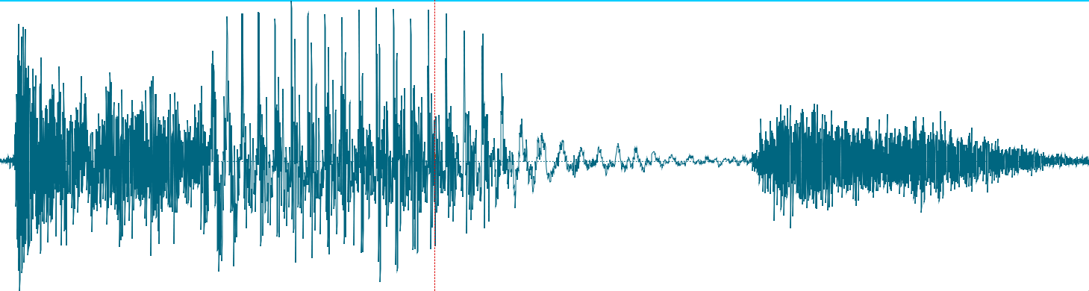
Montreal Forced Aligner: HMM transitioned by GMM
HMM
/æ/
/k/
/a/
/t/
GMMs
Frame1
Frame2
Notes:
13.5 HIDDEN MARKOV MOVELS + GAUSSIAN MIXTURE MODELS

Slide 18


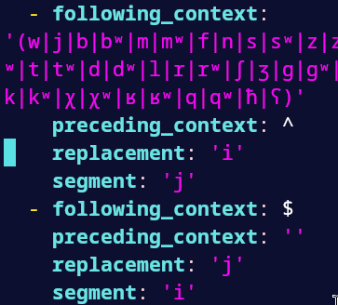
Montreal Forced Aligner
“stop”
Monophone models
Triphone model (context each side)
LDA + MLLT (maximize phone differences)
Unifying speaker information (Irrelevant)
Replacement rules (step 0)
Phone groups(triphone step)
b
Prev
Next
b:
Notes:
14.5

Slide 19
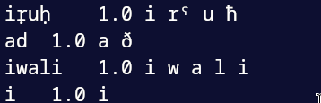
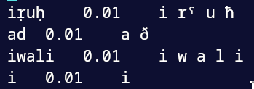
Implementation quirks: Pron. dictionaries
Possibility of a kab word when training on kab corpus is max, possibility of a kab word when adjusting to zgh corpus is minimal. Reverse also true
Kab version (kab words)
zgh version (kab words)

Slide 20
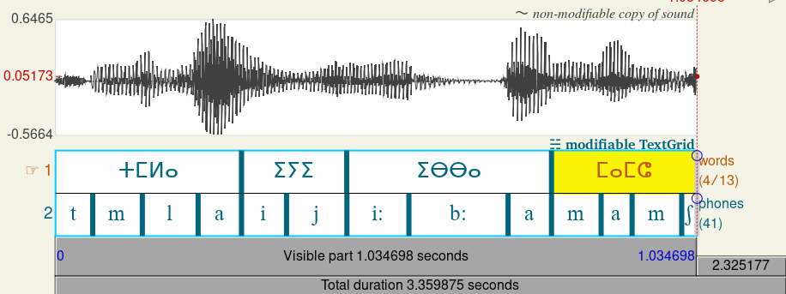
Implementation overview
Common voice/kab
Used to
Gen Pron. Dict*
MFA train
Gen TextGrid + Resample .wav
Common voice/zgh
MFA kab model
Common voice/zgh
TRAIN
MFA Adjust
Common voice/zgh
TEST
MFA zgh model
tzm**
Evaluation
TextGrid example
shi**
* with prob.
**20 longest samples of each
Notes:
17.5

Slide 21
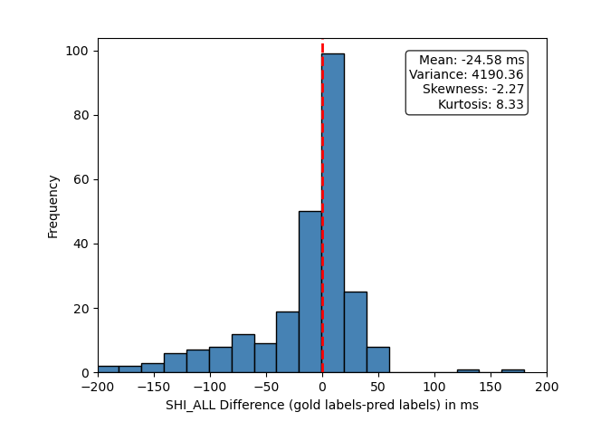
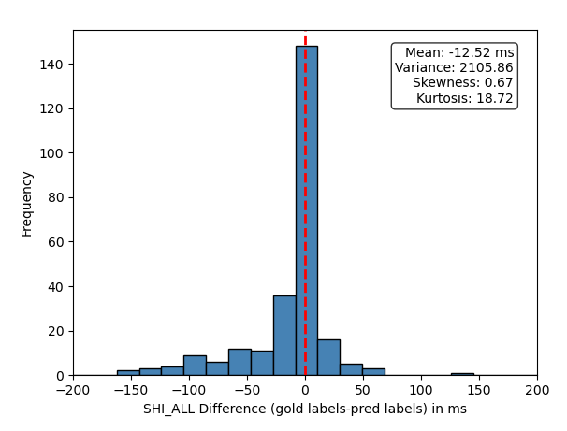
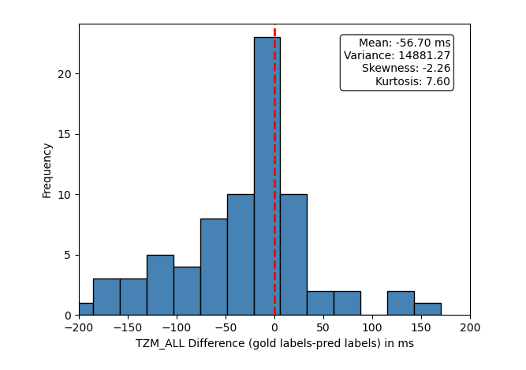
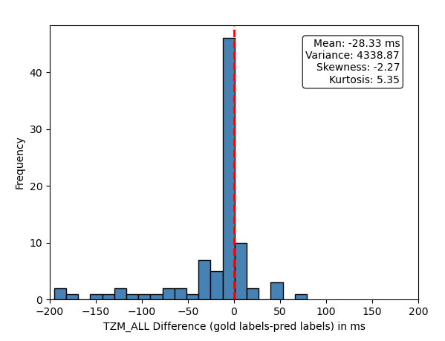
nokab
kab pretraining
shi
tzm
Notes:
1. TZM is part of a continuum 2. TZM has very few samples (SHI-centric MFA)

Slide 22
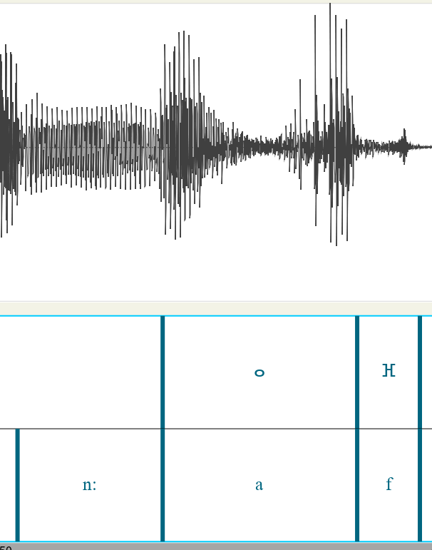
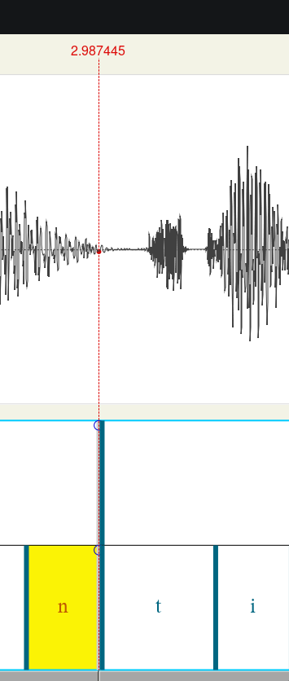
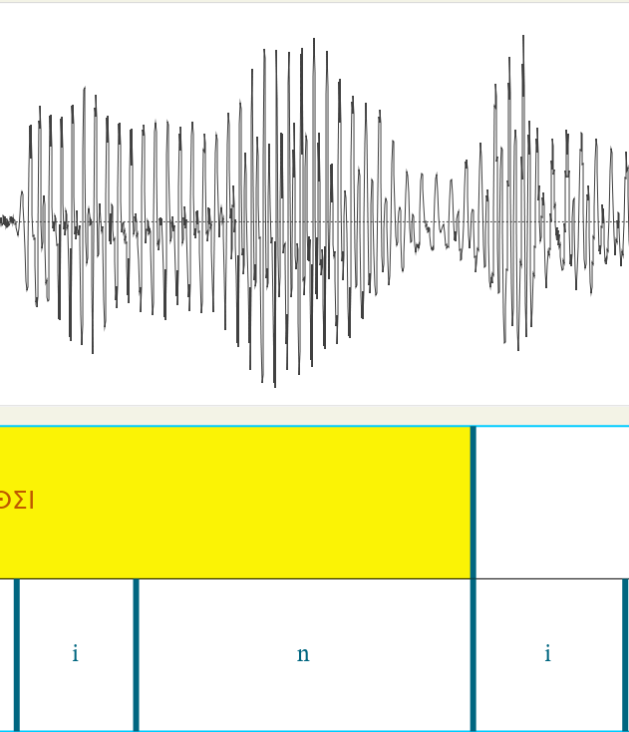
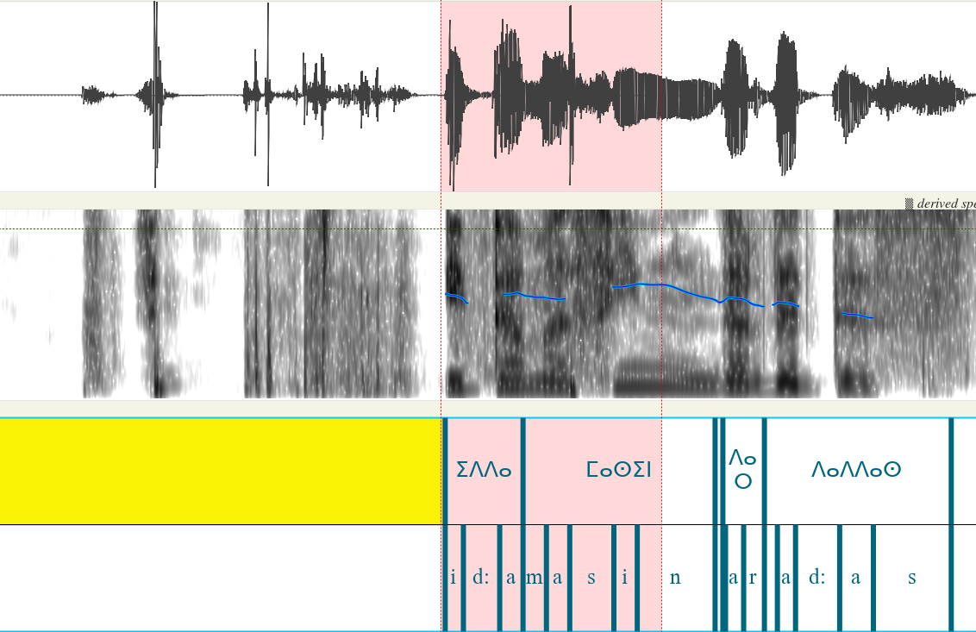
Results MFA: Good at in-phone irregularities
(Automated annotation) shi_0
(Automated annotation) shi_1
(Automated annotation) shi_3
(Automatic annotation) tzm_17
Knocking noises
Notes:
18.5

Slide 23
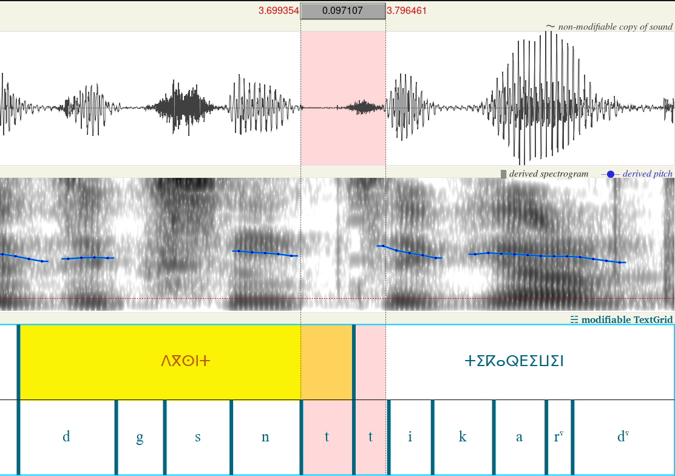
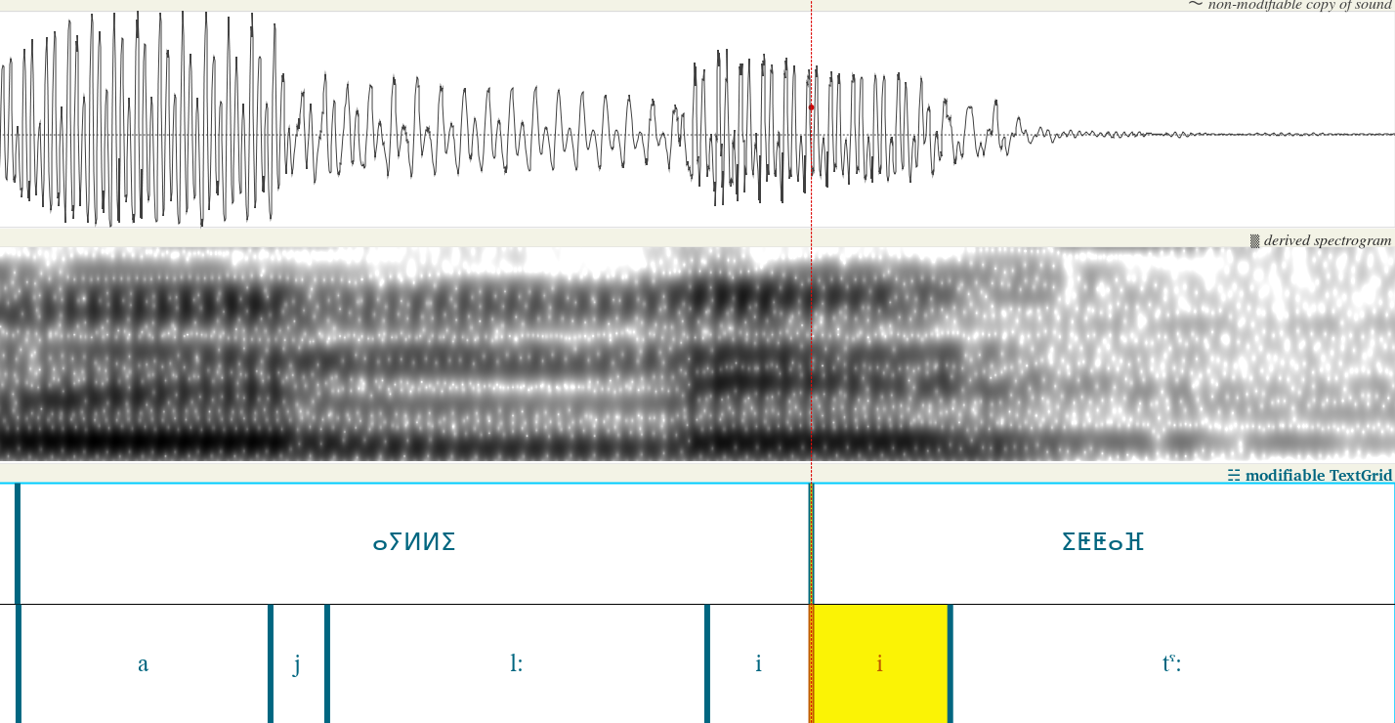
Manual analysis: MFA struggles with inter-word merging
(Automated labeling) /i/ does not get replaced by /j/ even when we give MFA the tools to do so. The same applies for inter-word geminate /t:/. Lack of corpus.
shi_2
shi_5

Slide 24
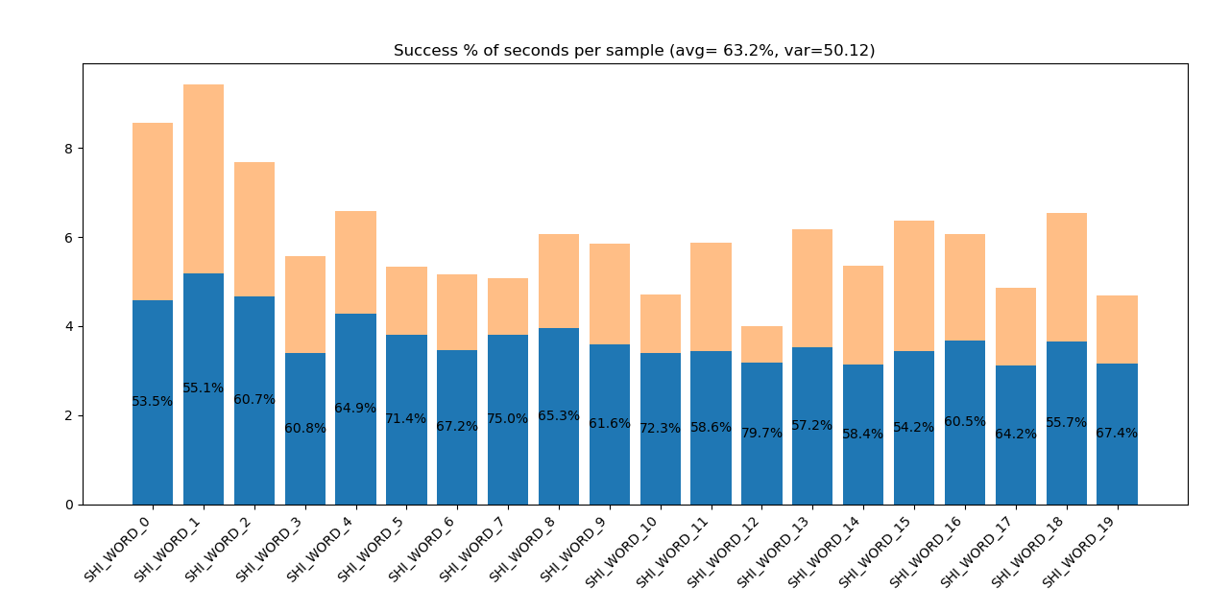
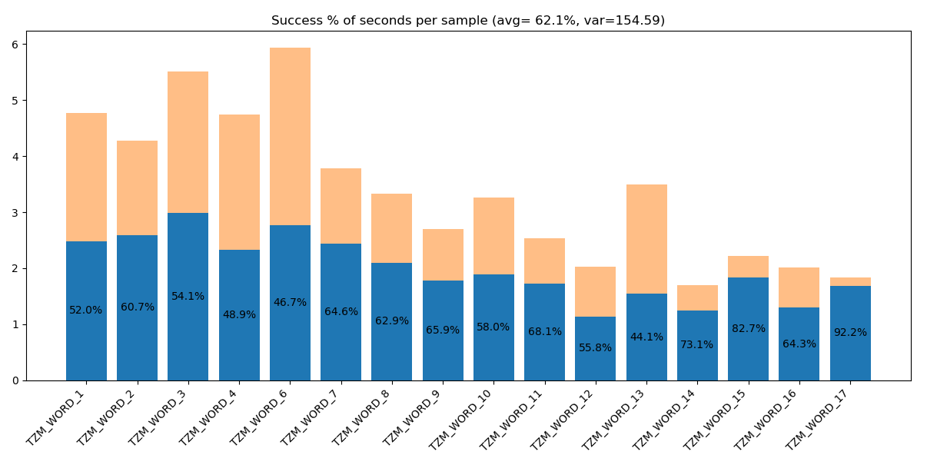
MFA word performance
shi
tzm
Notes:
Same avg, different variance

Slide 25
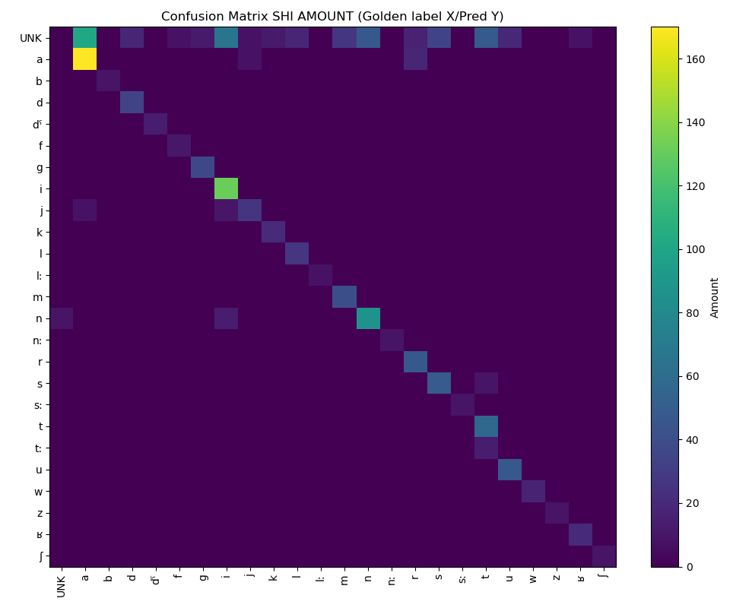
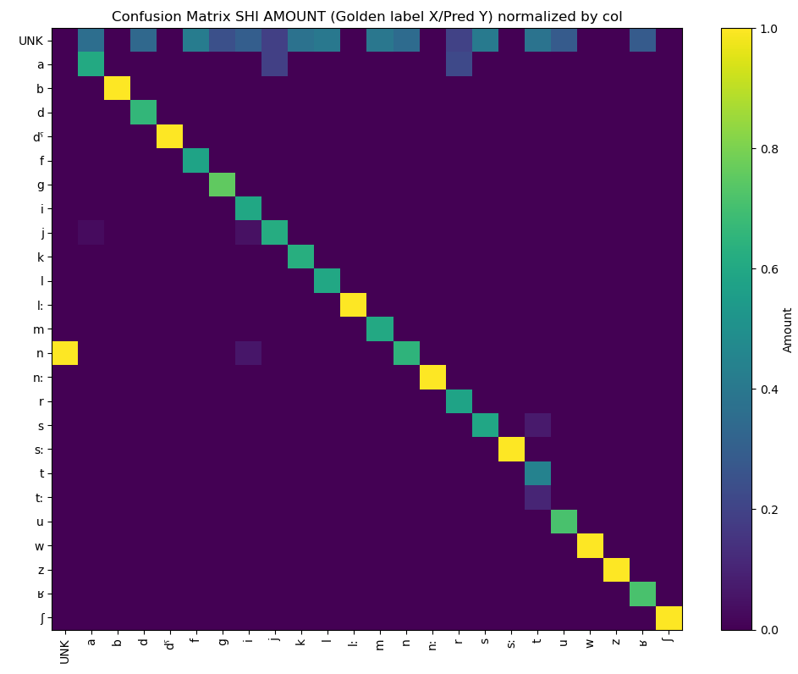
MFA phone performance: SHI AMOUNT
Min support 8
Notes:
Normalizing by column = Characters have not been well differentiated enough
Left: most common phones eclipse rest (a,i, n)
Right:
A is a most common mislabel (probably due to high freq)
Misslabel silence as n (it thinks N are longer)
Perfectly labeled consonants: No pattern, probably not enough occurrences to see mislabel patterns

Slide 26
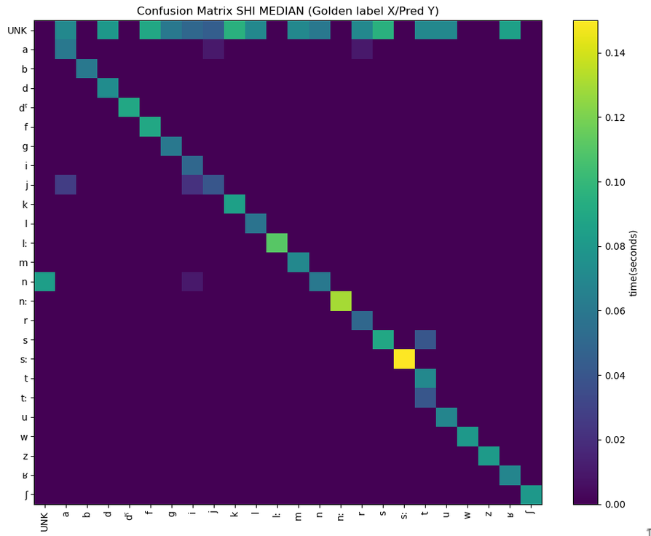
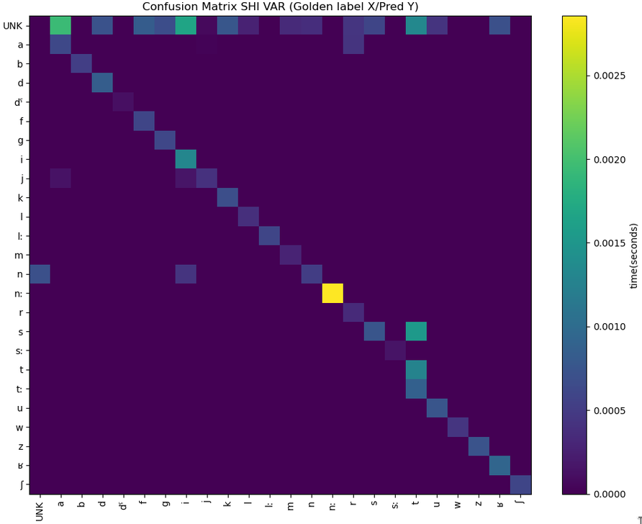
MFA phone performance: SHI MEDIAN + VAR
Min support 8
Notes:
MEDIAN: Could be consistently wrong patterns or my phonetician skills
High median on l:, n:,d_phar
High variance, which phonemes are also inconsistently wrong

Slide 27
Private dataset observations
/t/ is pronounced as a half-stop inbetween /n/, something similar to /nhn/
Spirantization /k/ -> /ç/
/ħ/ is not well learned
Emphatic consonants very off
Notes:
6.5

Slide 28
Conclusions
Using a pretrained MFA in a similar language significantly increases performance
Missing phones in base language WILL be an issue (e.g. /t:/)
More corpus needed for zgh (cross-word assimilations)
Mislabeled datasets will be a timewaster when low-resource
Pretrained similar language corpus >>> Overly-dialectal theoretical research
Notes:
6.5

Slide 29
Future suggestions
To solve geminate /t:/ underrepresentation:
  Grab slowest-speaker audios in kab dataset
  Label normal as geminate
Try vocoid in-between every consonant
Common Voice resampling: 25 hours of audio can take 150GB or 3GB
Aggressively generate ALL zgh realizations per-phone (spirant. Consonants have been seen in kab )
More informative evaluation
  Statistical per-phone support?
  Edit distance (not overlap)
  Vowel space visualization
Notes:
6.5

Slide 30

Notes on sources:
zgh
kab
Main source has been "Syllables in tashlhiyt berber and in moroccan arabic"
F Dell, M Elmedlaoui - 2002
Cross-compared with wikipedia’s source for shilha:
Ridouane, R. (2014). Tashlhiyt Berber. Journal of the International Phonetic Association, 44(2), 207-221.
And p.c with some native speakers (with a linguistic background):
https://www.linkedin.com/in/abdelhaqueidali/
https://www.linkedin.com/in/hichammellouki/
Main source has been wikipedia, cross-referencing with a native speaker: Kabyl Singer “Massyl Aït-Ahmed” https://www.youtube.com/@massinissaait-ahmed4875
Notes:
11.5

Slide 31
Questions
END

Slide 32
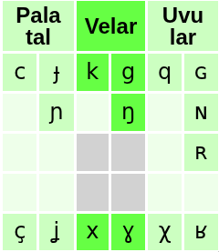
Notable considerations
Conflicting sources* for “ⴿ” (aspirantized “ⴽ”):
  According to Neo-Tifinagh* “ⴿ”-> /x/
  According to native speaker “ⴿ”-> /ç/
  Well-stablished that:
    “ⴽ” -> /k/
    “ⴳ” -> /g/
    “ⴴ” -> /ʝ/
    “ⴸ” -> /ð/
    “ⴷ” -> /d/
  “ⵅ” is (acc. to speaker /χ/, differentiated with /x/)
*https://en.wikipedia.org/wiki/Tifinagh#Neo-Tifinagh_letters
https://www.linkedin.com/in/abdelhaqueidali/

Slide 33
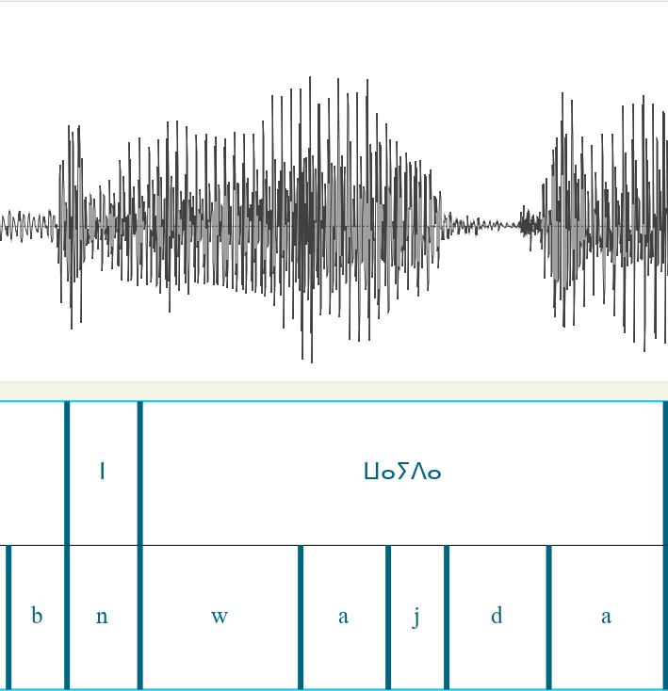
Manual analysis: Incongruence with source
(Manual annotation) “n” preposition pronounced /n/ before /w/ (according to "Syllables in tashlhiyt berber and in moroccan arabic" p. 46 this “n” should assimilate to /w/ as u, but /n/ is clearly audible)
shi/Common_voice_22_0_1

Slide 34
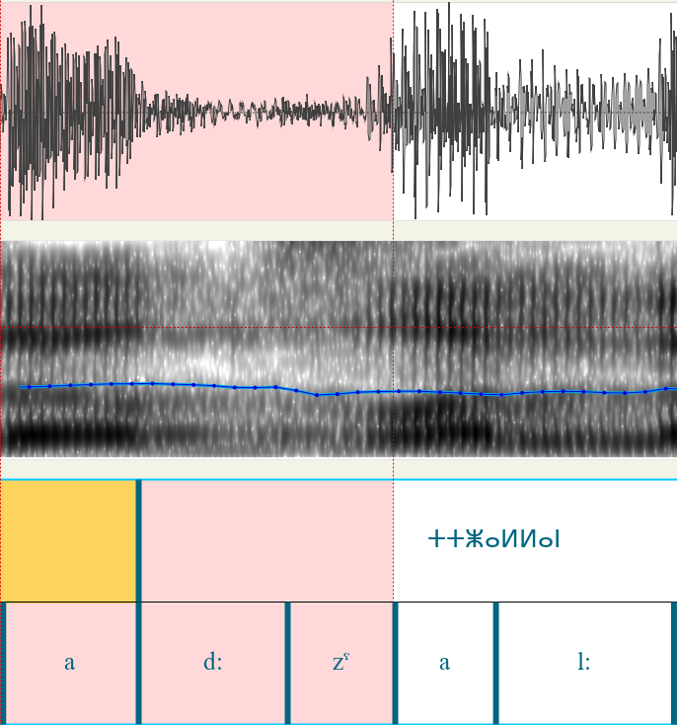
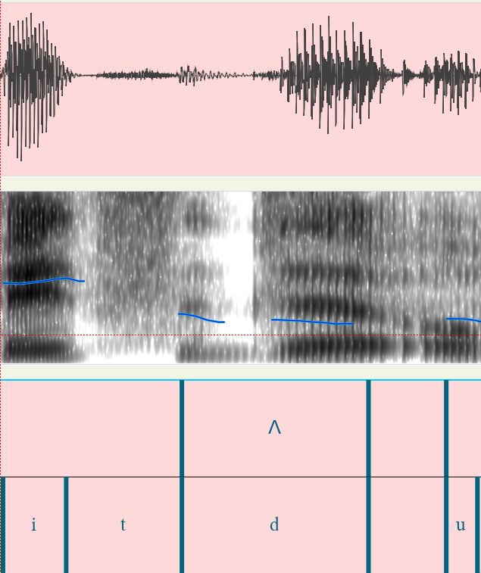
Manual analysis: Unaccounted assimilations
”t:” becomes voiced /d:/ when surrounded by voiced
”td” is /θd/ (may be speaker lisp)
tzm/Common_voice_22_0_7
tzm/Common_voice_22_0_4

Slide 35
Previous work
https://www.memcauliffe.com/how-much-data-do-you-need-for-a-good-mfa-alignment.html
Study on how many speakers are a good threshold to have for MFA particularly
Rough suggestion is 20 hours
“The more nuanced answer is that when there’s a pretrained model on 20+ hours of speech similar to the variety you’re trying to align, that will likely generate pretty good alignments”
https://montreal-forced-aligner.readthedocs.io/en/latest/user_guide/troubleshooting.html#errors-training-on-small-corpora
Official suggestion is 1000 hours for something generalizable but at least several (how many?) are needed.

Slide 36
Previous work
https://huggingface.co/datasets/TutlaytAI/kabyle_asr
https://huggingface.co/datasets/TutlaytAI/moroccan_amazigh_asr
Moroccan Amazigh ASR contains kab (not shi,tzm or zgh) and is clearly mislabeled. Given that common voice validates more reliably, dropping these both.

Slide 37
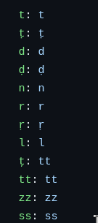
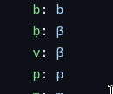

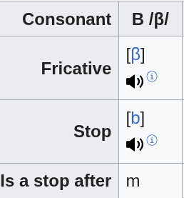
Previous work
From paper code:
Haberland, C., & Lao, N. (2021). Orthographic Transliteration for Kabyle Speech Recognition. In Proceedings of the 4th International Conference on Natural Language and Speech Processing (ICNLSP 2021) (pp. 21-32).
https://github.com/berbertranslit/berbertranslit/blob/main/data/latin_norm/latin_prealignment.yml
Good reproducibility, shallow domain knowledge (resulting in inaccurate implementation)
Interesting for comparison on per-consonant metrics
My findings:

Slide 38
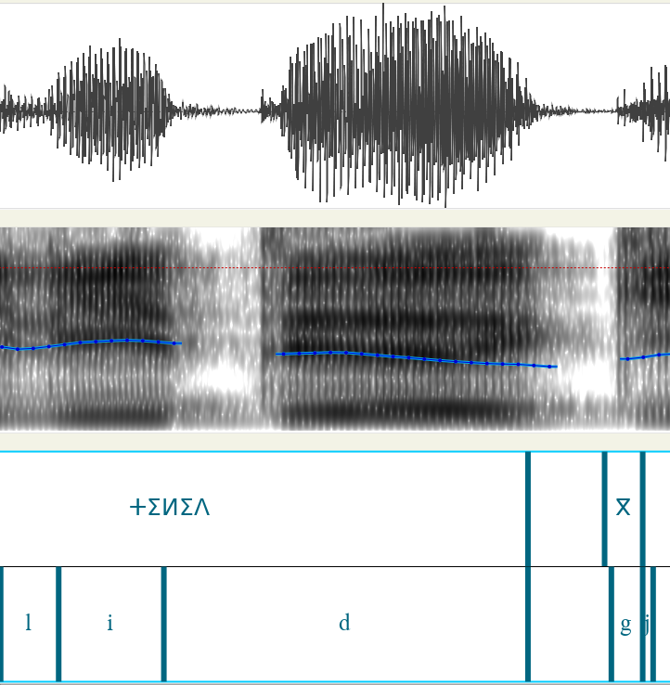
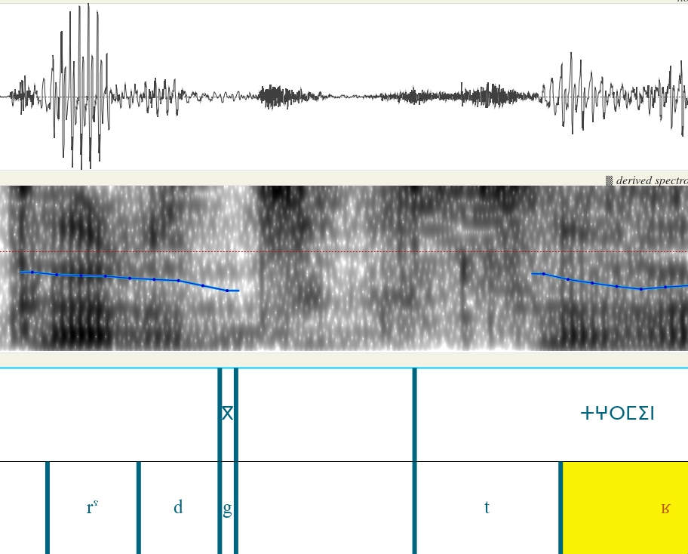
Manual analysis: Issues with solo consonants
shi/Common_voice_22_0_4
shi/Common_voice_22_0_5

Slide 39
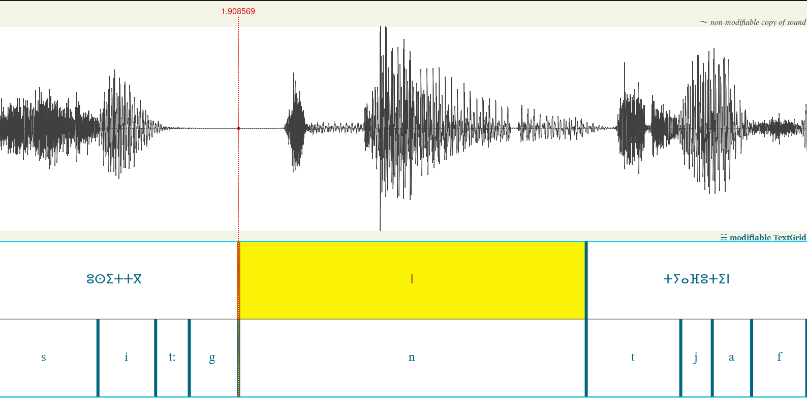
Manual analysis: limitations due to corpus size
(Automated annotation) gemminate “tt” not learned. Unsurprising given “tt” is /ts/ in kab but /t:/ in shi/tzm
shi/Common_voice_22_0_1

Slide 40
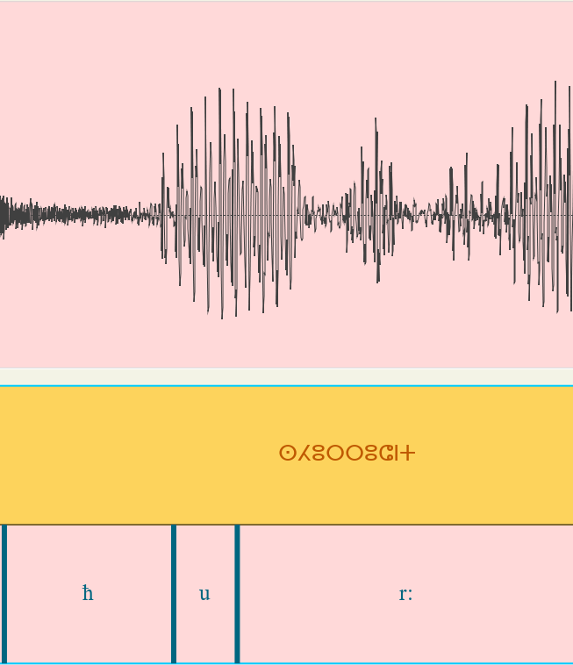
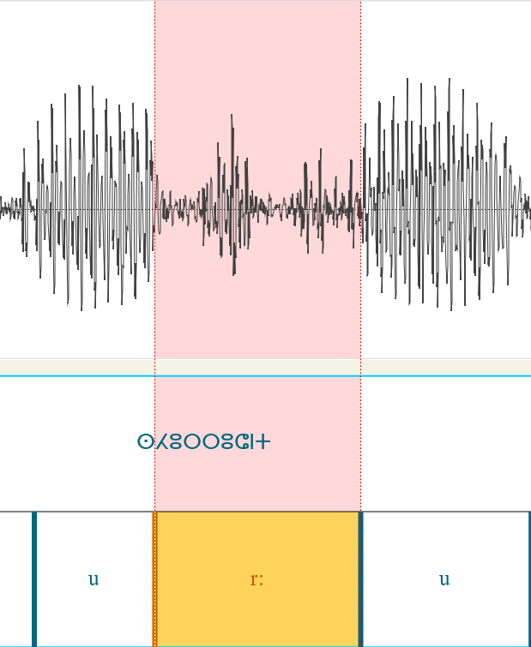
Manual analysis: MFA struggles in rhotic vs vowels
geminate aproximant vs. vowel threshold is difficult for MFA (left is automated, right is manual annotation). Strange because /r:/ is in kab. Anecdotally I can say that is not true for glides /w/ and /j/ vs vowels and nasals /n/,/m/ vs vowels.
shi/Common_voice_22_0_2

Slide 41
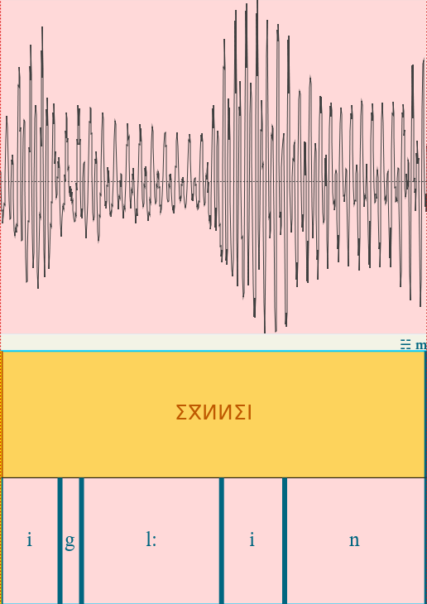
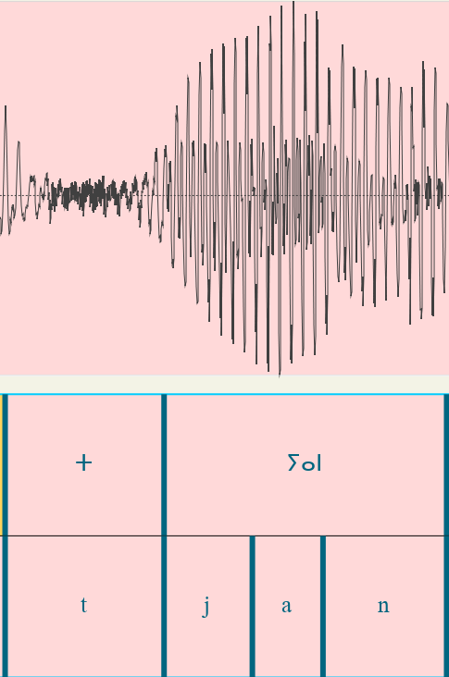
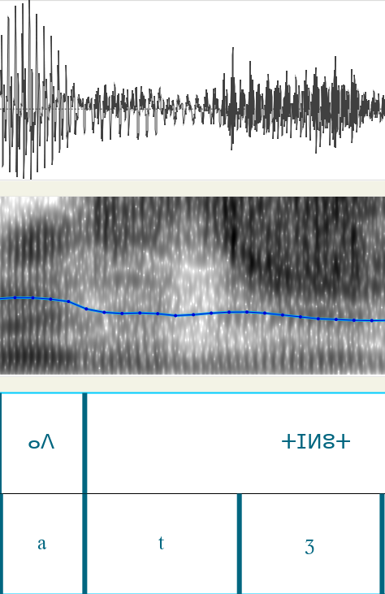
Manual analysis: Unaccounted assimilations
/igl:in/ is realized as /il:in
/t.jan/ is realized as /z.jan/
/adtʒ/ is realized as /az:ʒ/ (happens in /t/ and /d/)
shi/Common_voice_22_0_3
(also in Common_voice_22_0_6,
also in Common_voice_22_0_11,
also in Common_voice_22_0_12)
shi/Common_voice_22_0_3
shi/Common_voice_22_0_6

Slide 42
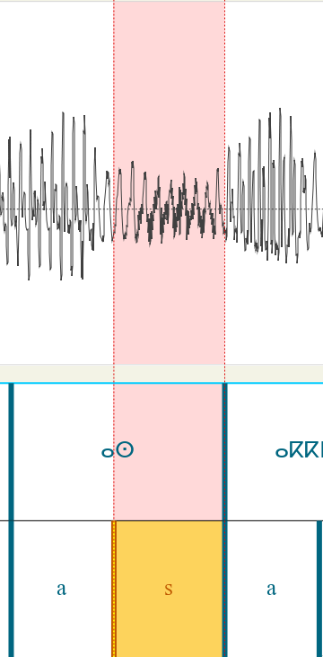
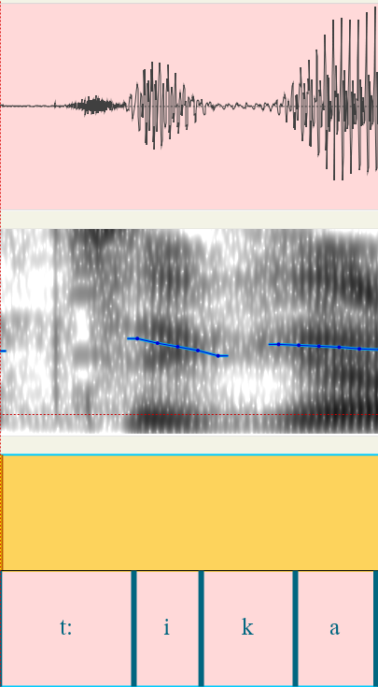
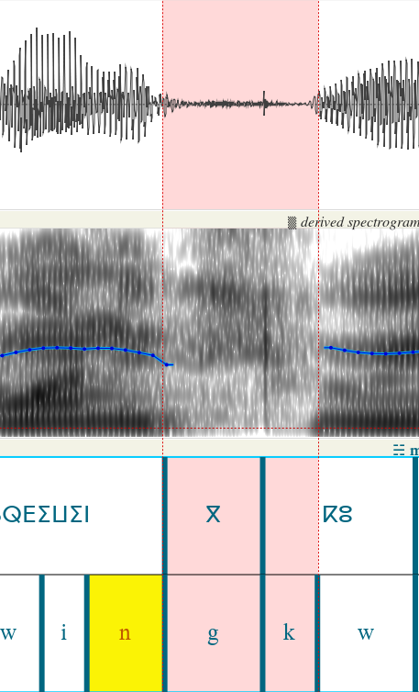
Manual analysis: Unaccounted assimilations
/k/ becomes voiced /g/ (betwen vowels and voiced such as /n/ /r/).
/g/ assimilates to /k/ AND spirantizes resulting in /ç/
Intervocalic /s/ becomes voiced /z/
shi/Common_voice_22_0_5
shi/Common_voice_22_0_5
shi/Common_voice_22_0_3

Slide 43
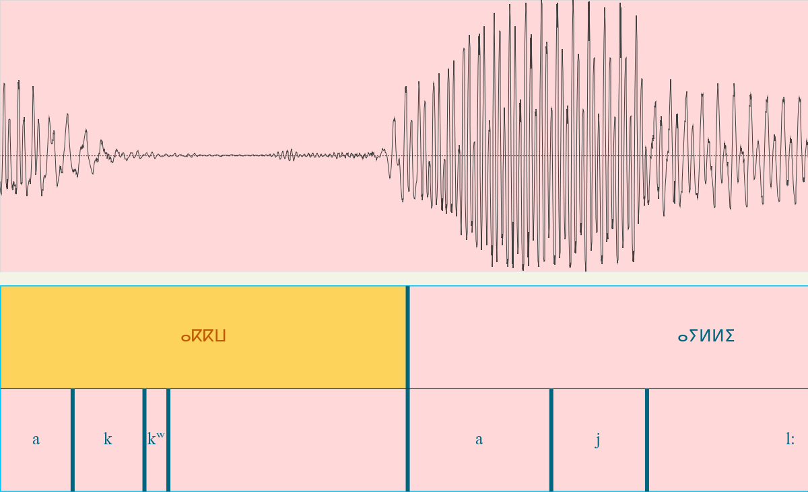
Manual analysis: Unaccounted orthography
Geminate + labialization = “ⴰⴽⴽⵯ ” would intuitively be /akkʷ/ but is pronounced /akʷ:/ (misslabel example)
shi/Common_voice_22_0_3

Slide 44
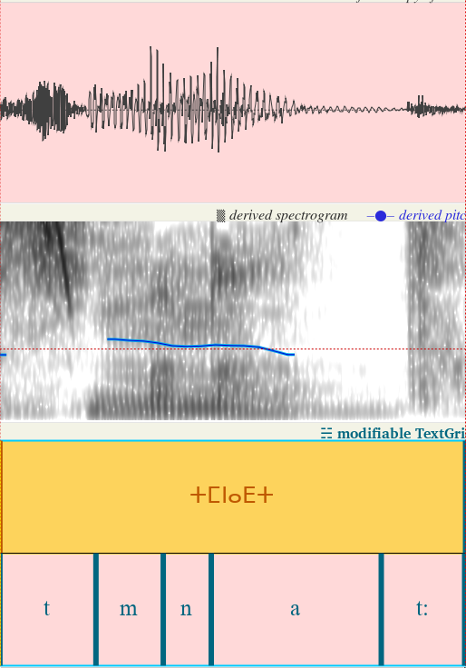
Manual analysis: Unaccounted orthography
d pharyng + t= /t:/ “ⵜⵎⵏⴰⴹⵜ”
shi/Common_voice_22_0_14

Slide 45
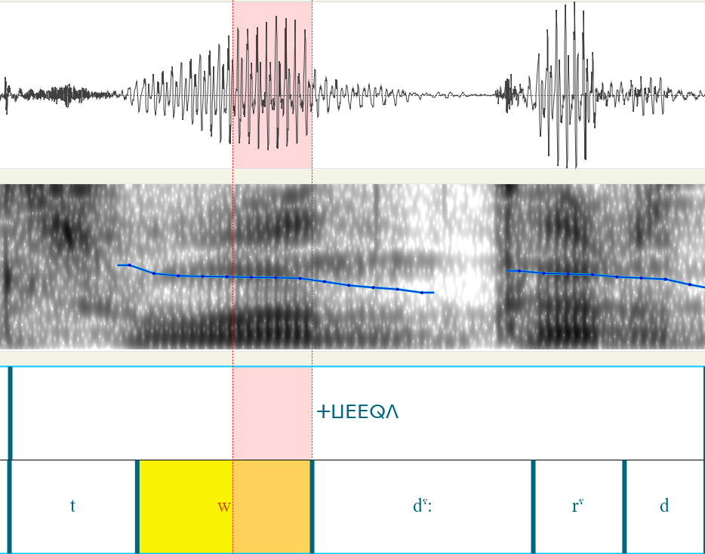
Manual analysis: Unaccounted orthography
Epenthetic vowels can be nasals (highlighted segment sounds like /n/)
shi/Common_voice_22_0_5

Slide 46
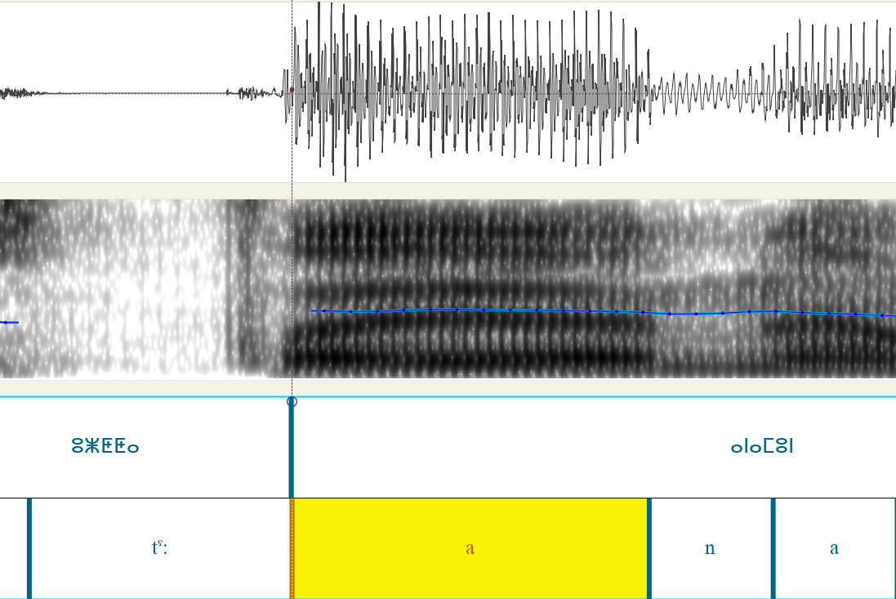

Manual analysis: Unaccounted assimilations
”t” is /s/ at pure ends.
Long ”a” may get /j/ inbetween (/aja/)
shi/Common_voice_22_0_9
shi/Common_voice_22_0_10

Slide 47
Manual analysis: Unaccounted assimilations
”t:” becomes voiced /d:/ when surrounded by voiced
”td” is /θd/ (may be speaker lisp)
tzm/Common_voice_22_0_7
tzm/Common_voice_22_0_4

Slide 48


Manual analysis: Unaccounted assimilations
”t” is /ts/ before some pauses
Unpronounced /s/
tzm/Common_voice_22_0_12
shi/Common_voice_22_0_10

